Slide 1
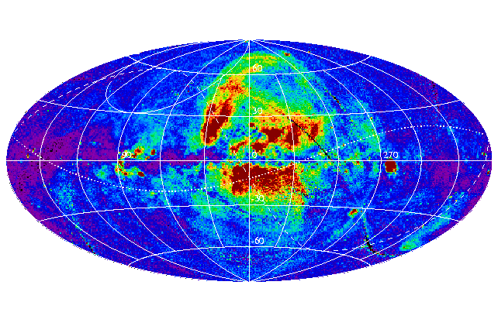
Mapping the North Polar Spur and its associated Expanding HI Shell
Team Darkstar
May 5, 2015

Slide 2
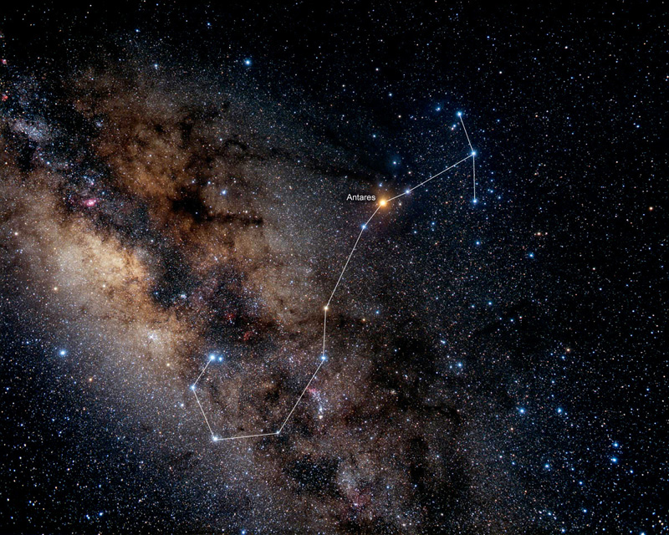
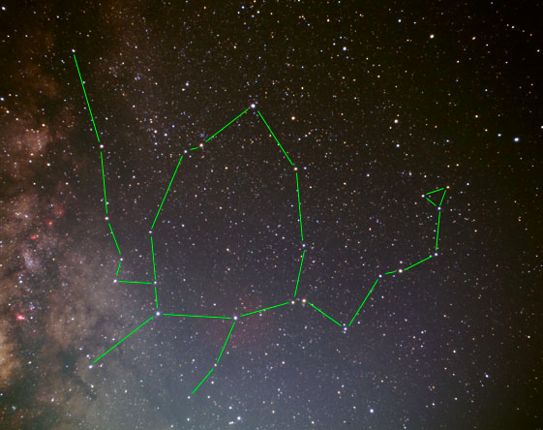
North Polar Spur
Huge shell produced by several energetic stellar winds and supernovae located in the Scorpius - Ophiuchus association of stars

Slide 3
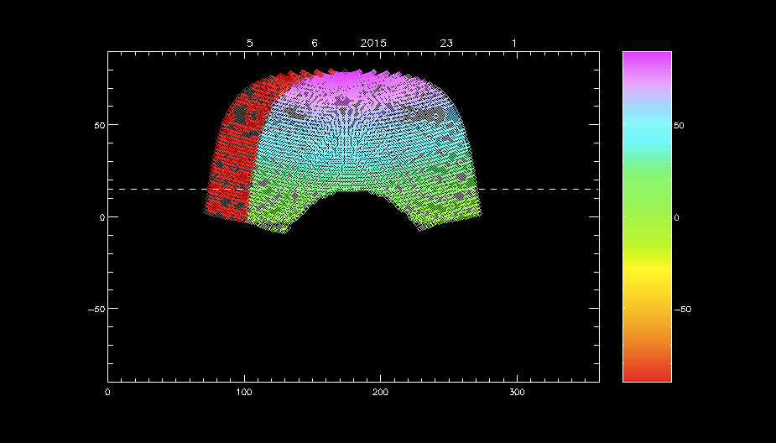
Mapping Area
map the shell in 3-D space of l, b, v
galactic latitude, longitude, and velocity!
l = 200° → 40° b = 0° → 90°
Notes:
Mahrud can talk about how he chose to sweep the l and b when taking data based off this map

Slide 4
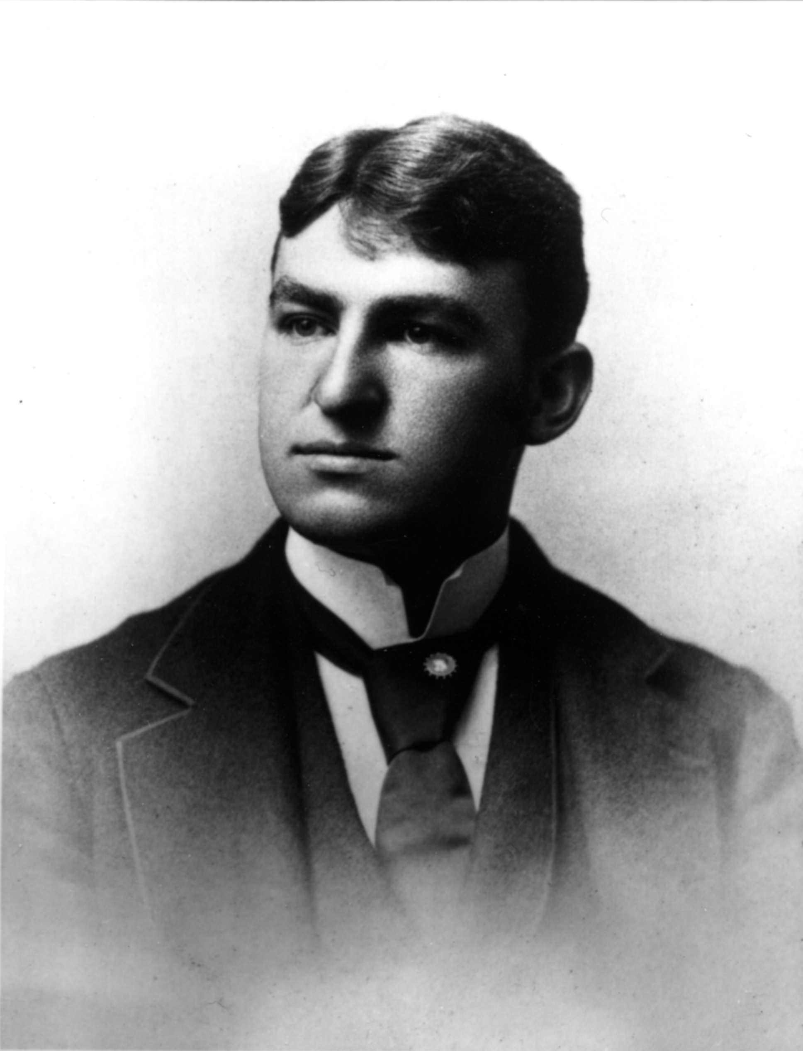
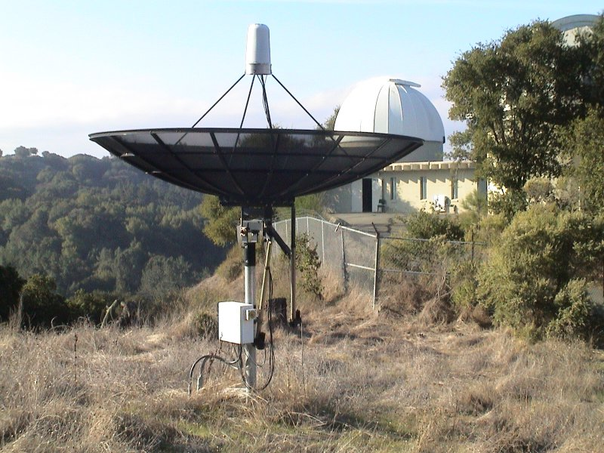
Leuschner Observatory

Slide 5
Receiver Diagram
Polarizer
Amplifier
Bandpass: Center 1540MHz +/- 240MHz
Mixer: LO 1270MHz for HI
Bandpass: Center 150MHz +/- 5MHz

Slide 6
Procedure

Slide 7
Velocity Calibration

Slide 8
Magnitude vs Location

Slide 9
Velocity vs Location

Slide 10
Peak Separation vs Location

Slide 11
Stepping Through Velocities

